Slide 1

Starbucks at Wells Hall
Team 3 & 7
Juan He
Ryan Yau
Ying Lu
Yeong Soo Kim
Hyen Kyu Park
April 27, 2015

Slide 2
Why Wells Hall Starbucks??
Right next to our classroom
Easy to get a data for the group project
Easy to get a coffee at Wells Hall
Easy to observe for students in STT 461
Everyone likes coffee!!

Slide 3
Contents
Data Collection
Finding the Maximum Net Profit
  Sampling Entire Day(7:00 a.m. ~ 9:30 p.m.)
  Sampling M.A.E(Morning Afternoon Evening)
Potential Problems

Slide 4
Data collection
We collected 19 obervations for 5 minutes for each.
  Number of cups of drinks sold
  Number of employees

Slide 5
Revenue per day
We used Monte Carlo function to estimate the revenue at Wells Hall Starbucks.
We approached in two different ways
  Estimation for one entire day.
  Estimation split into morning, afternoon, evening(M.A.E)

Slide 6
Continued..
We used the observations to estimate the number of cups sold each day
From each estimation of cups sold, we sampled from a Starbucks menu to estimate the revenue per day

Slide 7
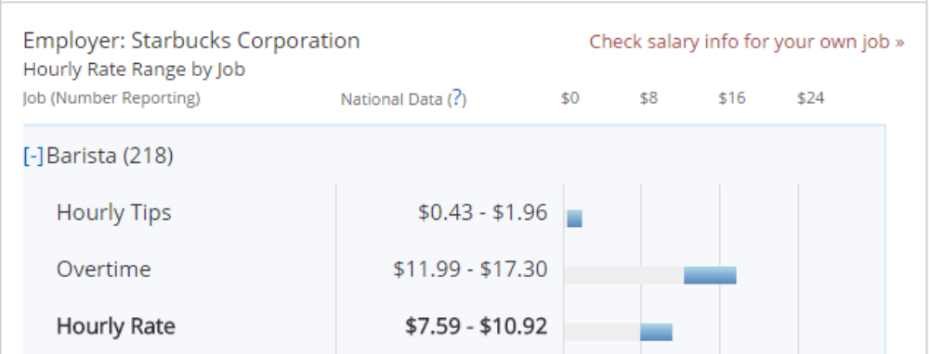
Estimating the profit
We calculated hourly rate.
Caption 1

Slide 8
Estimating the profit
We made a use of a uniform distribution to sample wages.
We used a minimum wage of 8.15$ in Michigan.
Then, we subtract total wage from the revenue.

Slide 9
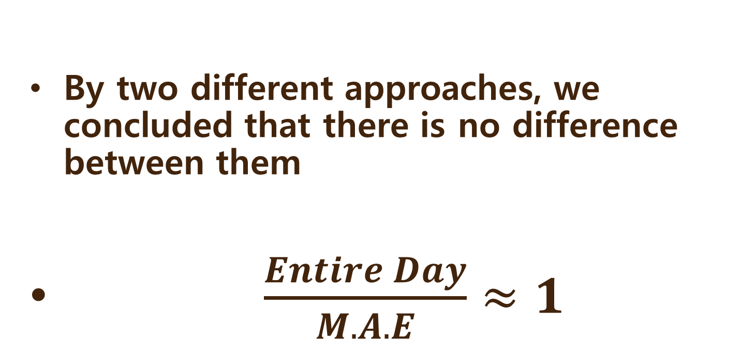
Entire day VS M.A.E.

Slide 10
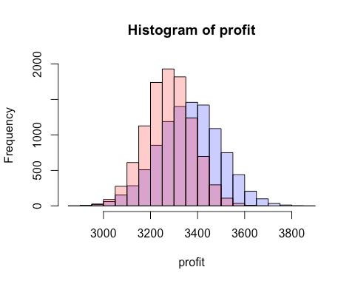
Entire day vs. M.A.E.

Slide 11
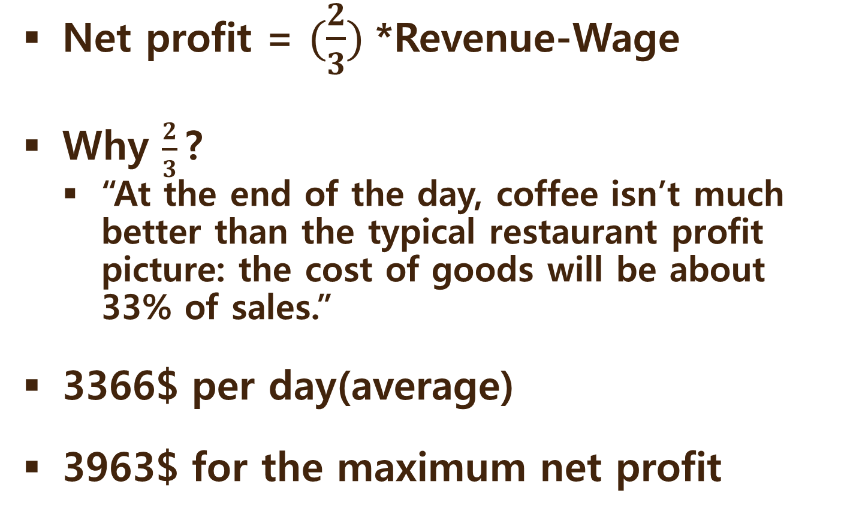
Conclusion
caption2

Slide 12
Potential Problems
Sample size is not large enough
We didn’t count for rent, utility and any other cost.
We don’t know what drinks everyone bought.

Slide 13
Citation
Caption1
  http://www.payscale.com/research/US/Employer=Starbucks_Corporation/Hourly_Rate
Caption2
  http://www.quora.com/How-much-profit-does-Starbucks-make-on-a-typical-coffee
Site: http://www.fastfoodmenuprices.com/starbucks-prices/

Slide 14

Thank You!

